Slide 1
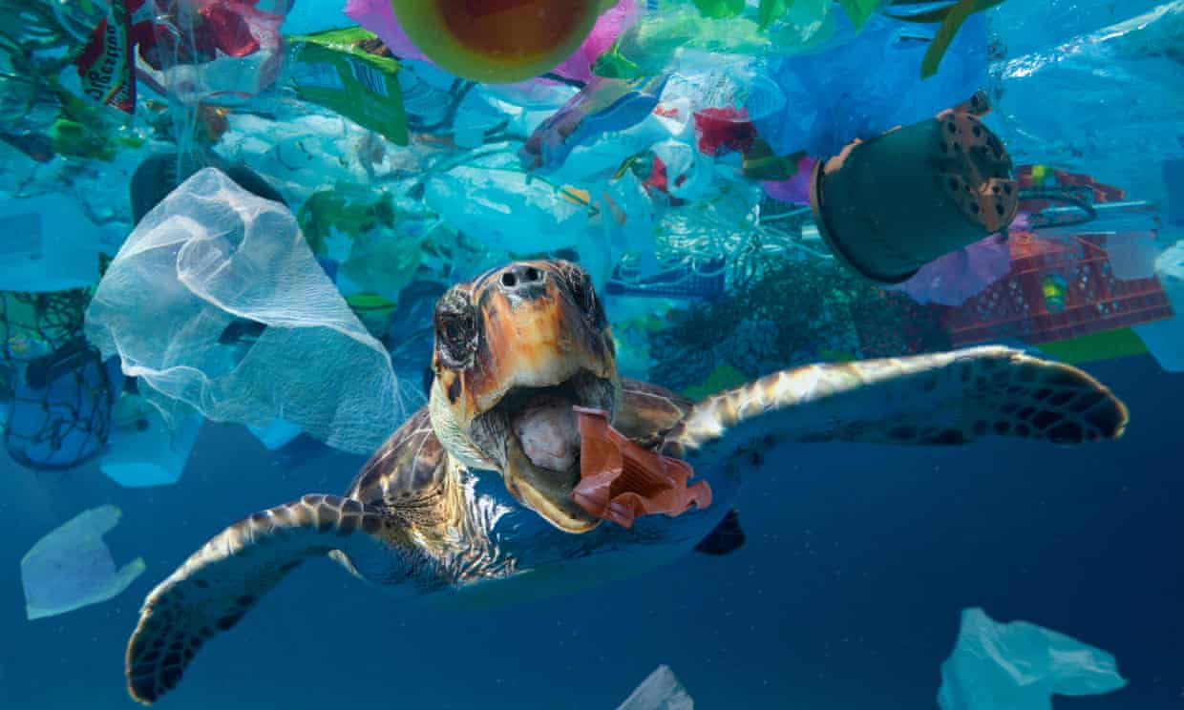
Plastic PullOutCean
A trip surrounded by plastic

Slide 2
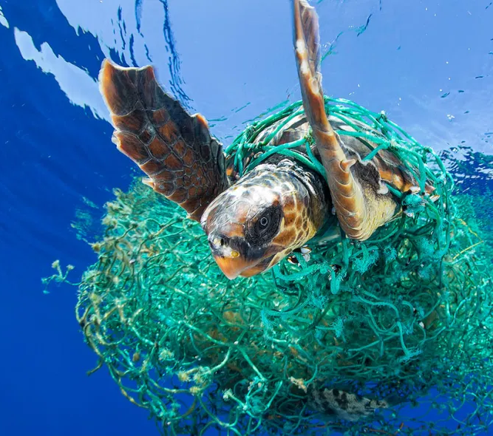
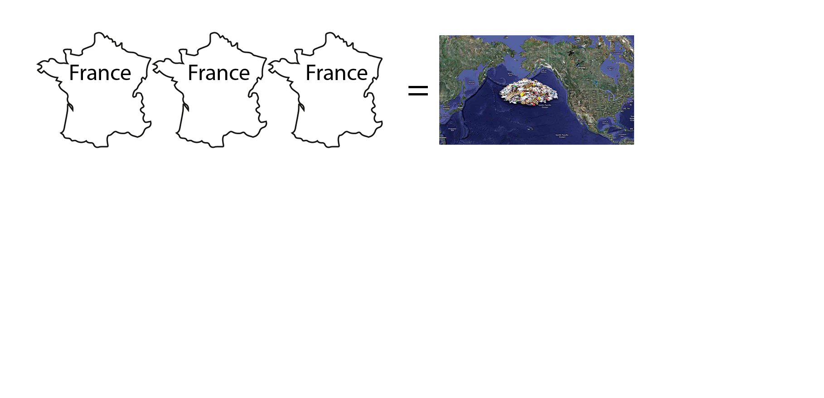
The context
Day by day, plastic is flowing into our natural environment. The end point of this trip is often the Ocean.
The amount of plastic into the ocean increases by a quantity equivalent to 33800 plastic bottles every minute, now it is like 3 times France’s surface.
Every year, ocean pollution kills 100000 animals surrounded by our plastic garbage.
Not so many people care about it. We are all part of the problem, but now it is time to be involved in the solution!

Slide 3
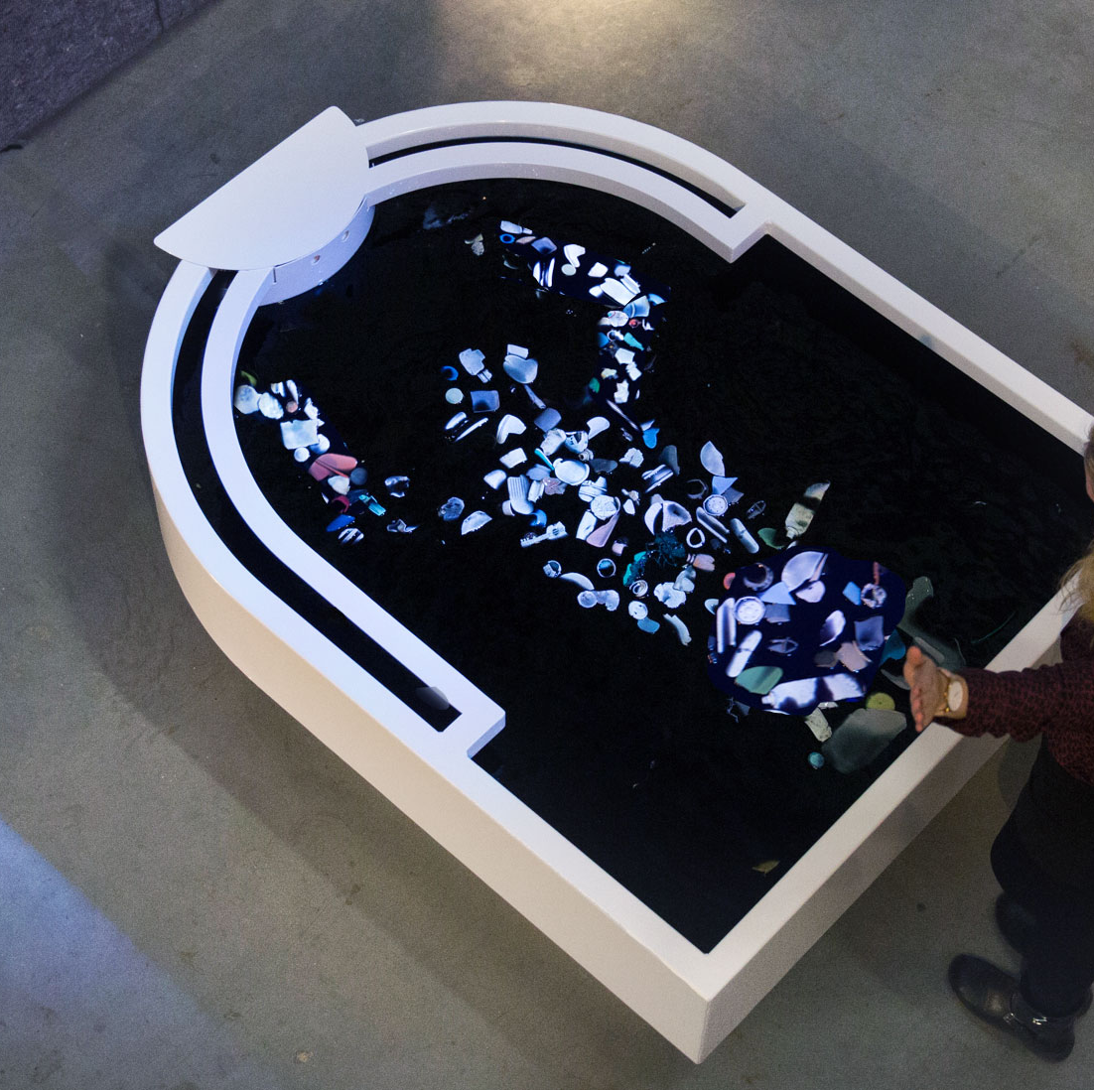
State of the art
Artistic installations
Sculptures in recycled plastic
Educational games online for kids
“Plastic Reflectic”, a plastic reflective- interactive installation by Thijs Biersteker, Plastic soup Foundation
Awareness campaign spots

Slide 4
The idea
Plastic PullOutCean is a project to allow people to really feel how is to suddenly swim into an ocean full of plastic.
In order to rise the awareness around this issue, through a claustrophobic experience surrounded by plastic, without the chance to escape, unless using an ecological behaviour.
The idea is to create an interactive installation, where virtual reality and good action in real world are connected to find a way to clean the real and virtual ocean.

Slide 5
Critical aspects
Grades of intensity of experience
Modulation of bad and good feelings
Level of knowledge about this topic
Interest in the subject

Slide 6
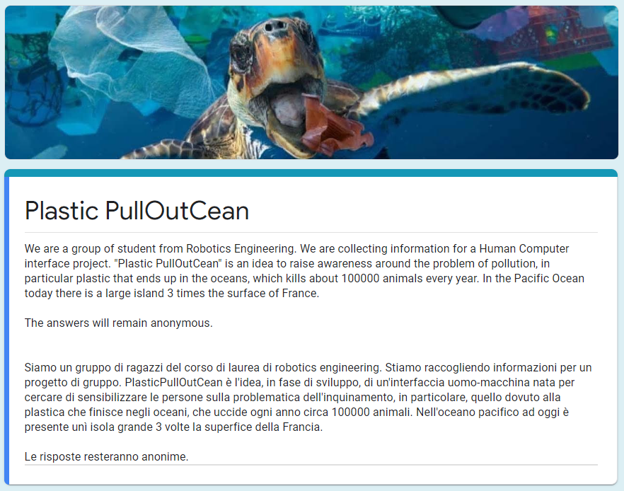
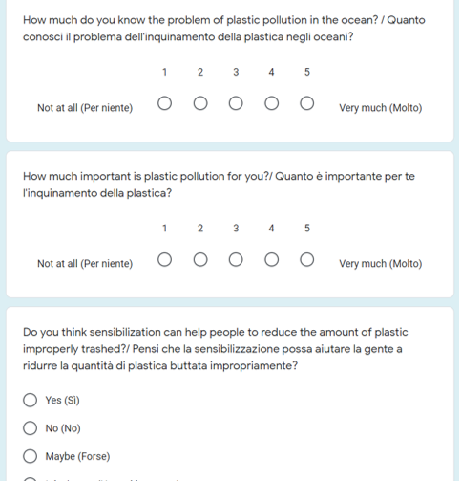

Methods of investigations
Questonnaire
https://forms.gle/6jArf4z2ZEpf8jxP9

Slide 7
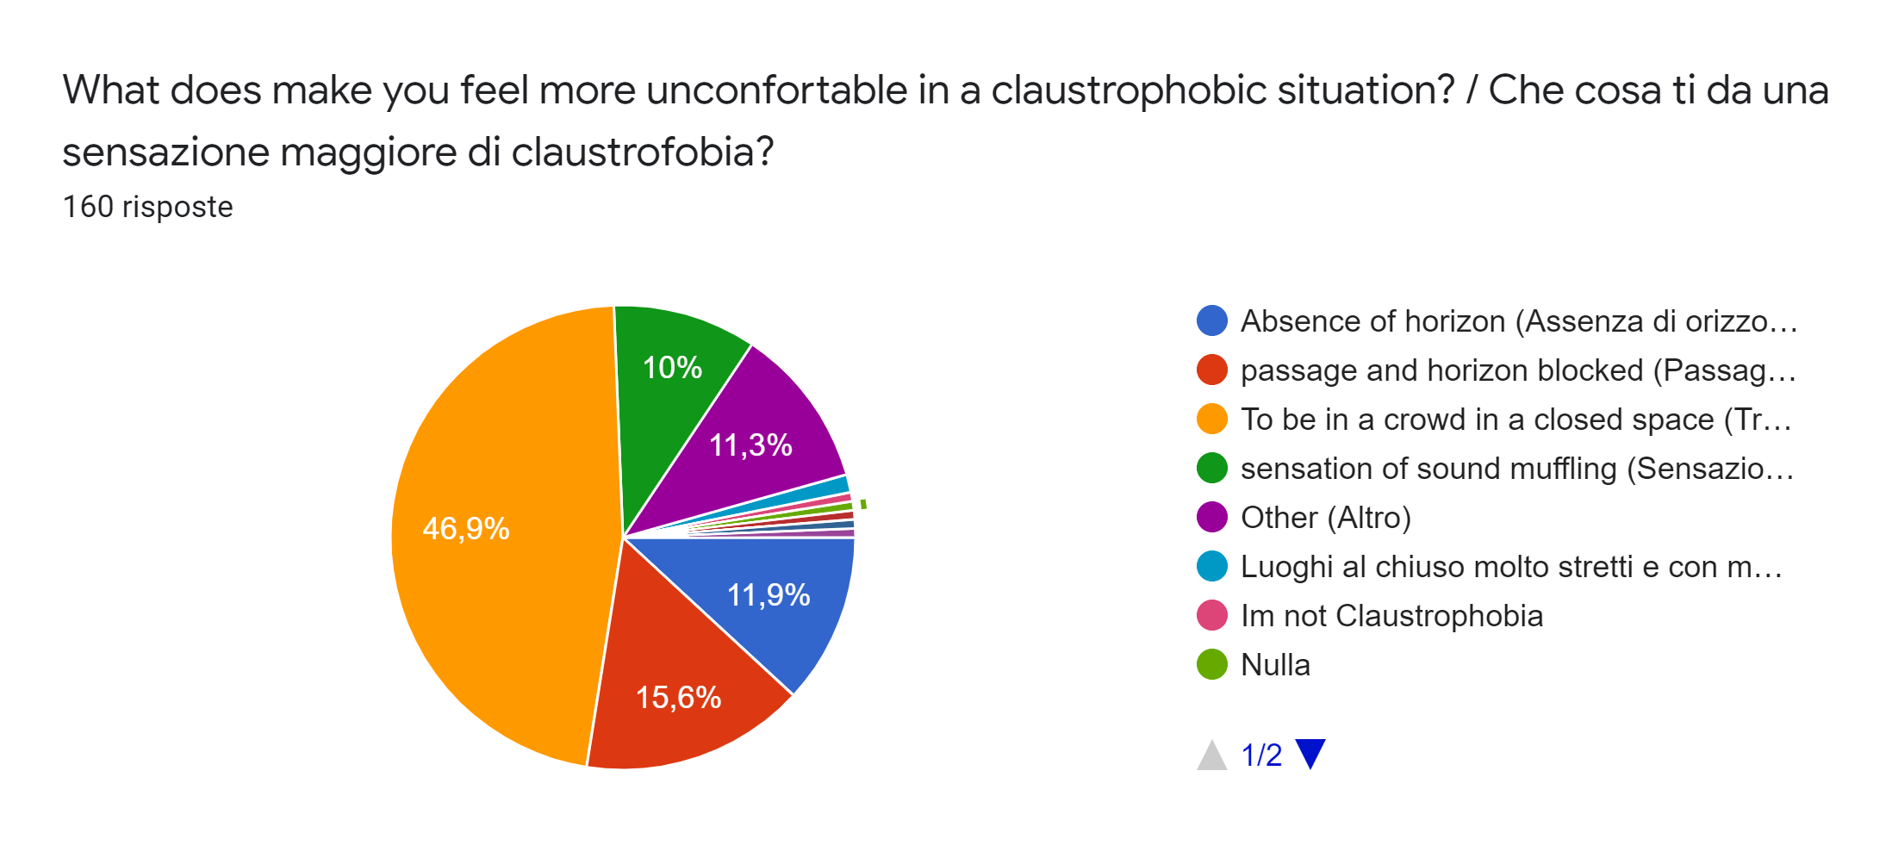
Results of data analysis

Slide 8
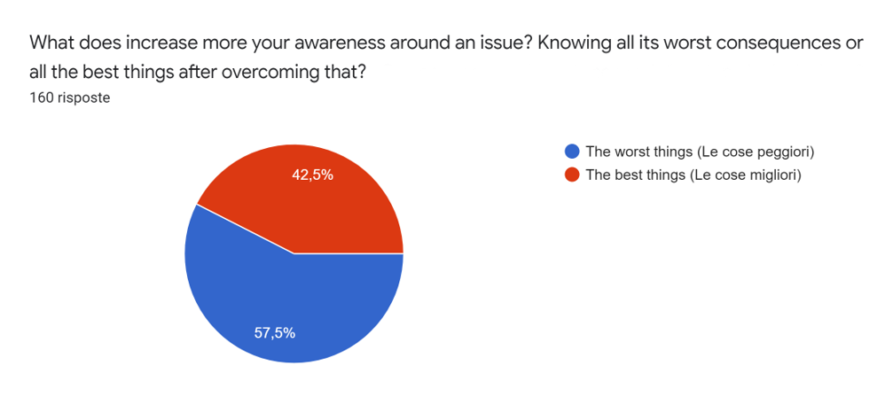
Results of data analysis

Slide 9
The experience
Mix virtuality-reality
A trip between an artistic exposition and an interactive game
Full emotional experience: transition from bad feelings to good feelings
Two different levels: one with soft and the other one with hard claustrophobia
Active participation in solving the problem from the user point of view
Living a complete arch of story to increase emotional engagement

Slide 10
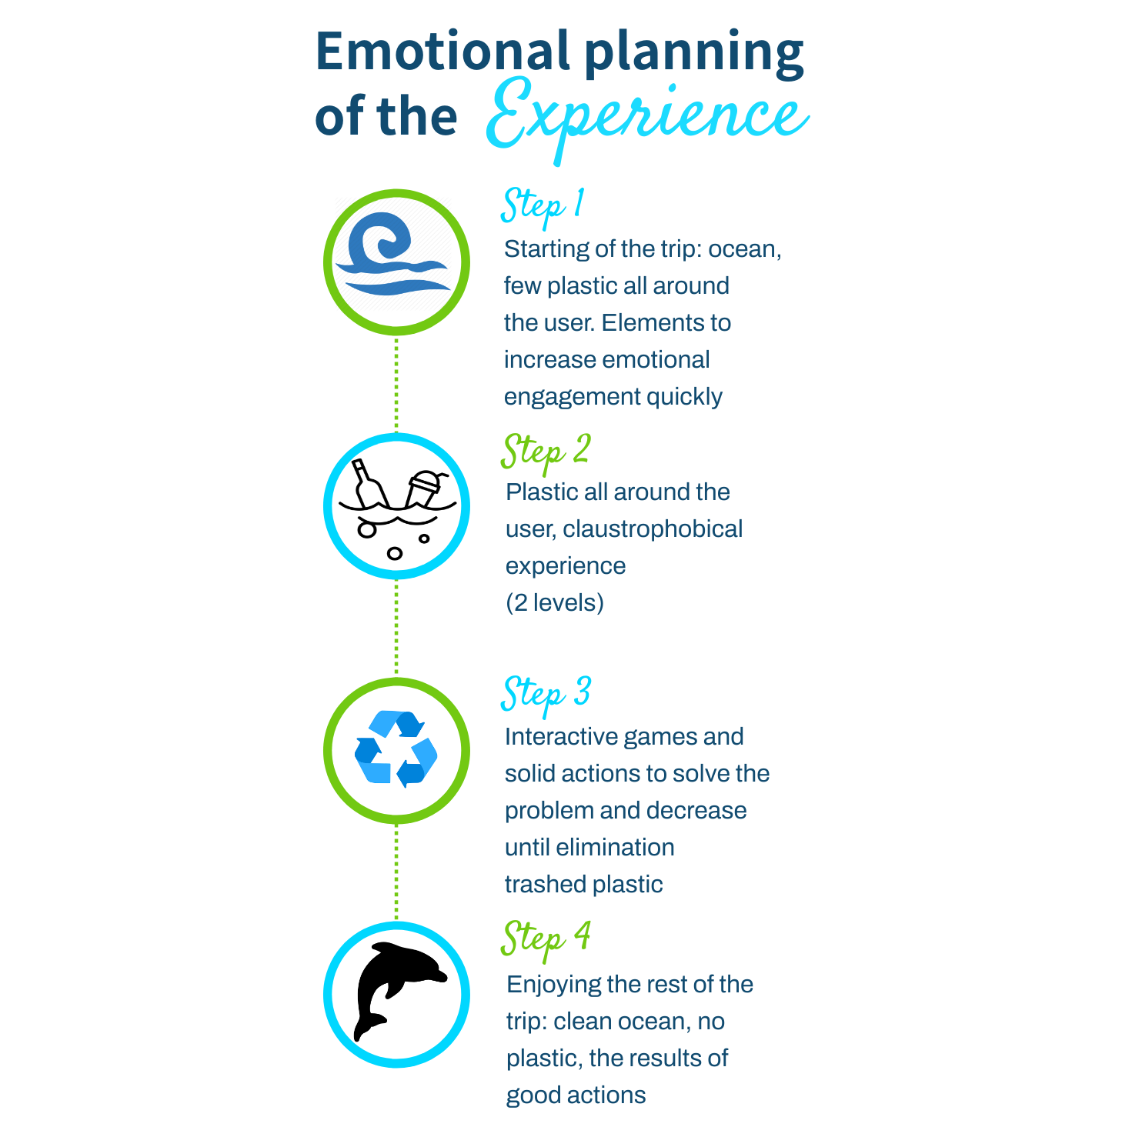
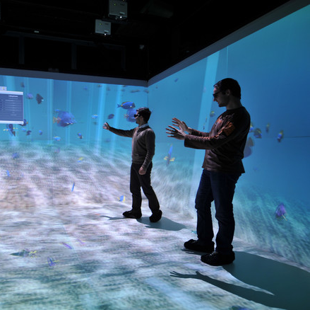

Slide 11
Future development
Interview with experts.
Creation of 2 different scenarios of intensity
A full emotional trip that gives bad and good feelings.
Different steps from education to real involvement.
Links to projects of organizations for collecting plastic in the ocean.

Slide 12
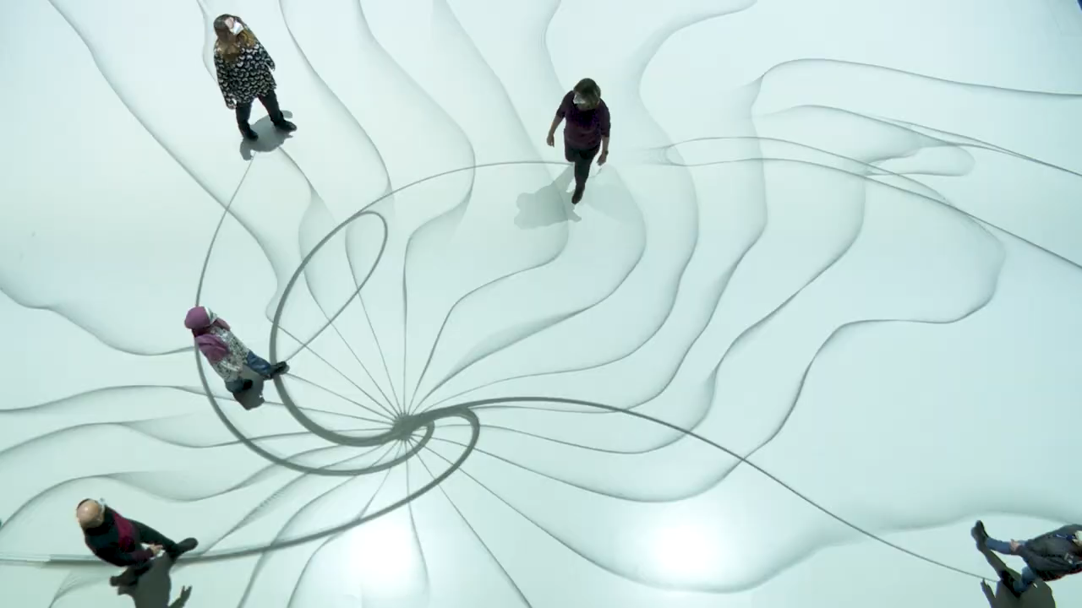
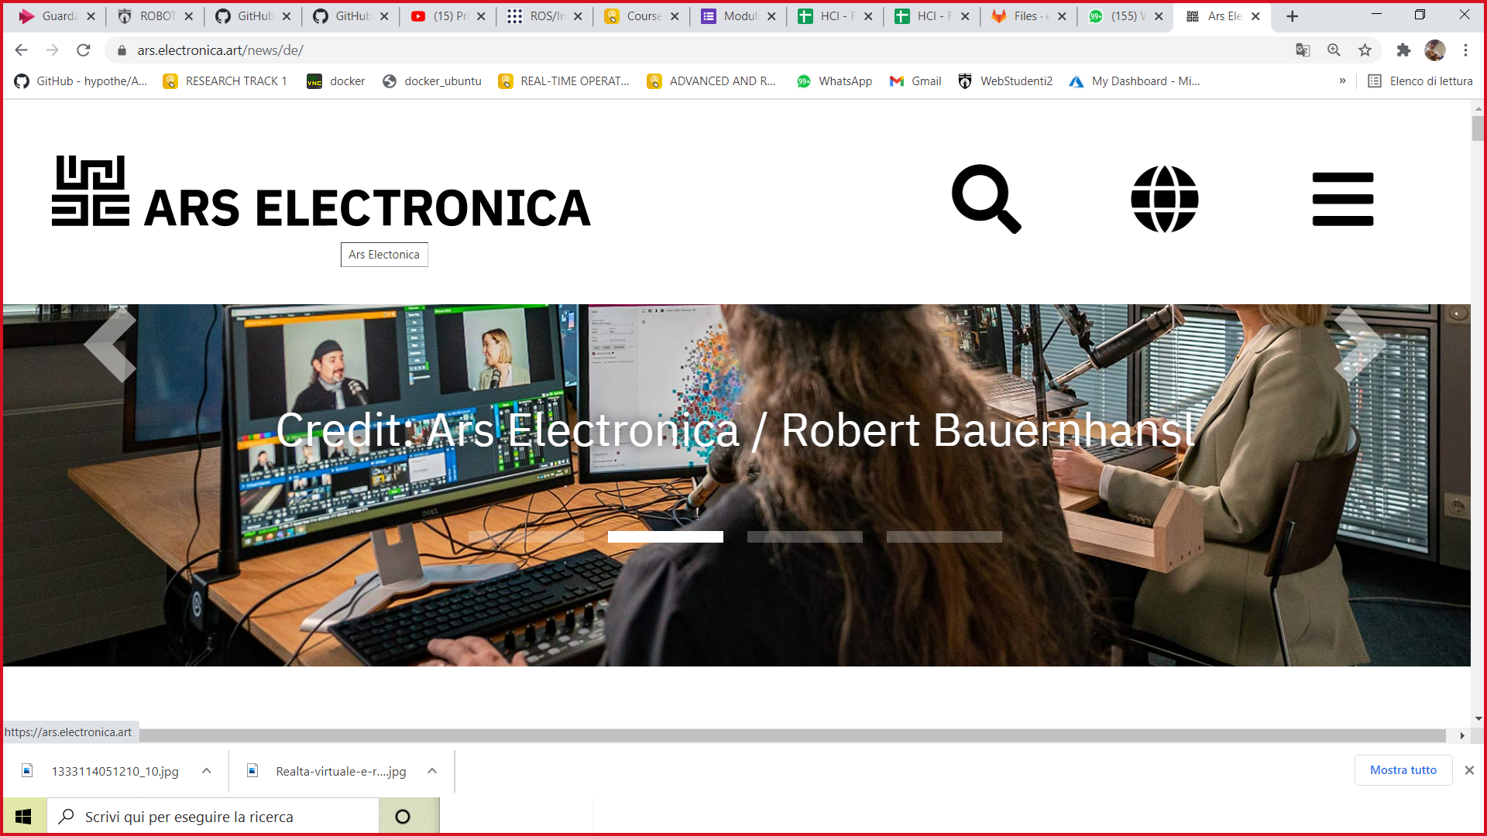
Others interactive exhibitions’ companies
https://ars.electronica.art/news/de/

Slide 13
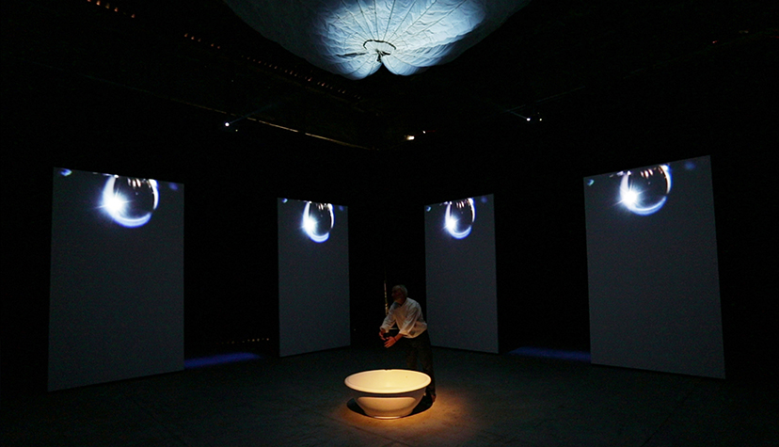
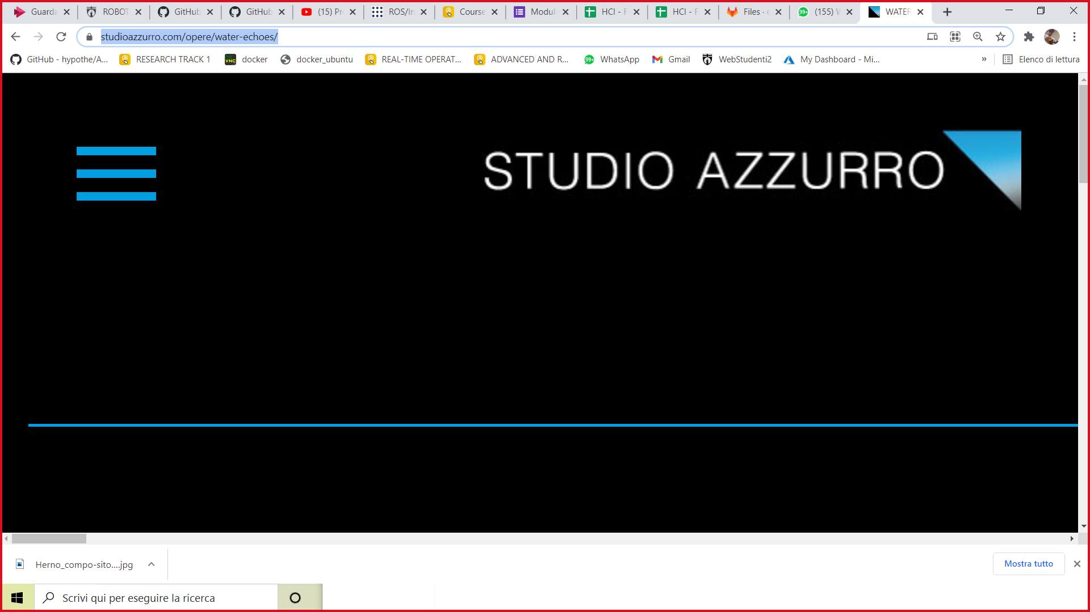
Others interactive exhibitions’ companies
https://www.studioazzurro.com/opere/water-echoes/

Slide 14
Purpose
Educational
Increase awareness
Try an unique experience

Slide 15
Target
Environmental organization (WWF, Greenpeace ecc… ecc…).
National governments and international organisations.
Aquarium.
Component within the exhibitions.

Slide 16
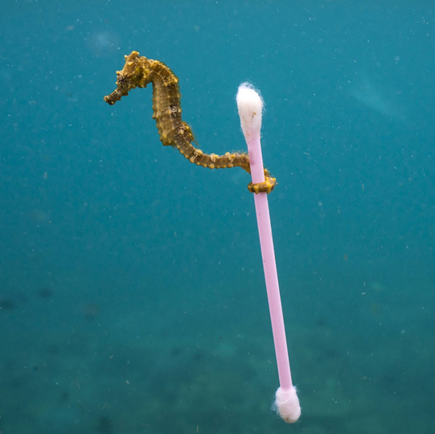
Our team
Ilenia D’Angelo, Mechanical engineer
Ileniadangelo94@gmail.com
Giovanni Di Marco, Electronics engineer
giovannidimarco06@gmail.com
Riccardo Zuppetti, Computer engineer
Riccardo.zuppetti@icloud.com

Slide 17
Thanks for the attention

